Slide 1
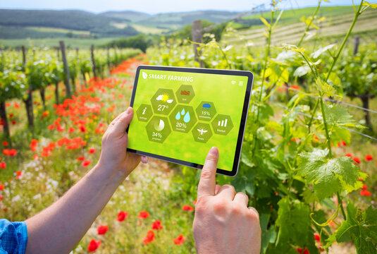
TEAM – D:
FARMVERSE PRECISION AGRICULTURE MANAGEMENT PLATFORM
Presented by:
Shirisha Regoti
Sangita Das
Roshini Samanta
Rishav Choudhary
Pooja Sri

Slide 2

The Problem
Manual farm record-keeping is holding growers back
No real-time visibility
Soil conditions and field/crop metrics aren’t tracked as they change.
Error-prone paper records
Manual logs lead to inaccurate, inconsistent farm and crop data.
Hard to scale
Managing multiple farms manually is slow and doesn’t grow with the business.
Delayed decisions
Poor monitoring means resource waste and lower crop yield.

Slide 3

Centralized Data
Role-Based Access
Proposed Solution
All user, farm, and crop records stored securely in one MySQL database.
Secure login with Admin, Farm Manager, and Guest/Viewer permission levels.
A centralized, web-based platform that replaces paper records with real-time digital farm management.
Farm & Crop Modules
Interactive Dashboard
Add, view, update, and delete farm and crop records with live status tracking.
One unified view of all farms and crops for fast, informed decisions.

Slide 4



Core Modules
Three modules power the platform end to end
User Module
Farm & Crop Module
Dashboard Module
Register & login
Role-based access
Profile management
Add / edit / delete farms
Track crop growth status
Link crops to farms
Unified farm overview
Real-time status view
Reporting & monitoring

Slide 5



System Architecture
A clean three-tier architecture
Presentation Layer
React.js frontend — dashboards, forms, and role-based views
Business Logic Layer
Spring Boot REST APIs — CRUD services and authentication
Data Layer
MySQL database — Users, Farms, and Crops tables

Slide 6
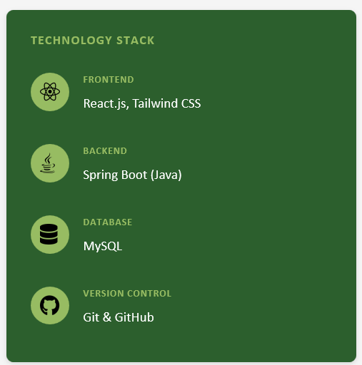
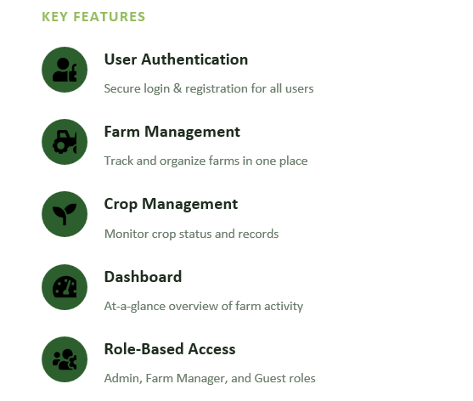
Features & Tech Stack

